Slide 1

Chapter 4
Present-worth analysis
现值分析

Slide 2
Main contents
Part 1
Part 2
Part 3
Part 4
Payback
period
投资回收期
Summary
Present Worth
Analysis
现值分析
Present Worth
Analysis
现值分析
  Evaluating a
  single project
  Comparing Mutually
  Exclusive Alternatives

Slide 3
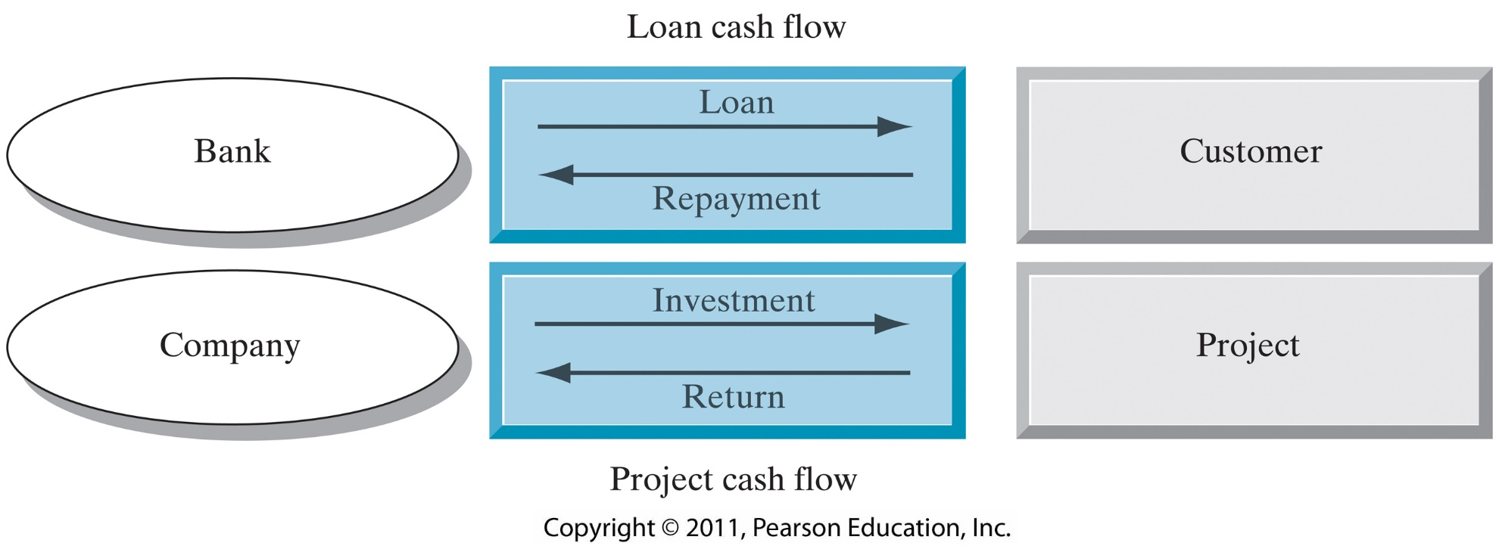
Chapter 4
Opening Story – money flowing out or flowing in?
Loan & Project Cash Flow:

Slide 4
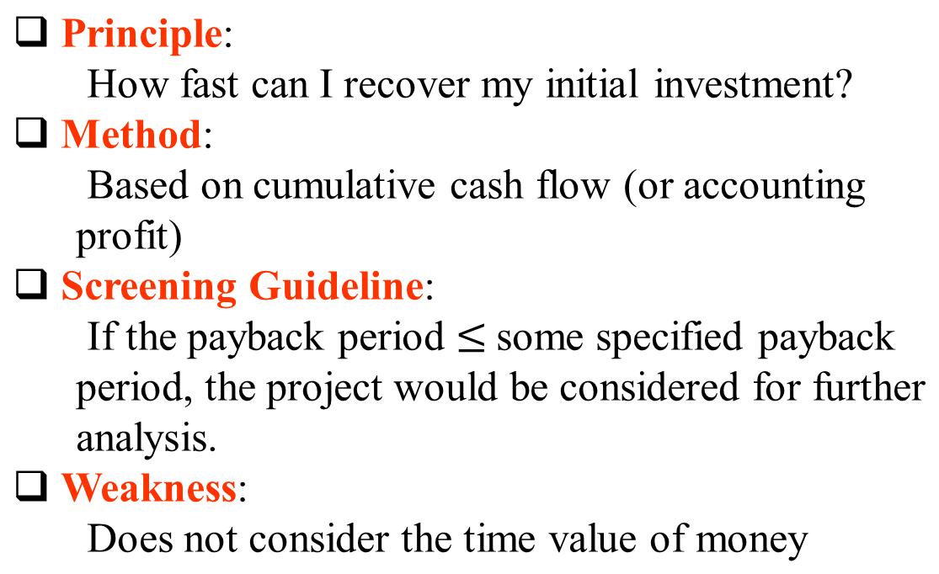
5.1 Payback Period
5.1.1 Conventional Payback Period 静态回收期

Slide 5
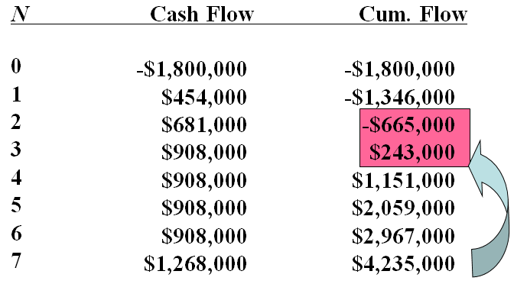
Example 5.1
Payback Period
Payback period should occurs somewhere
between N = 2 and N = 3 or 2.73 years

Slide 6
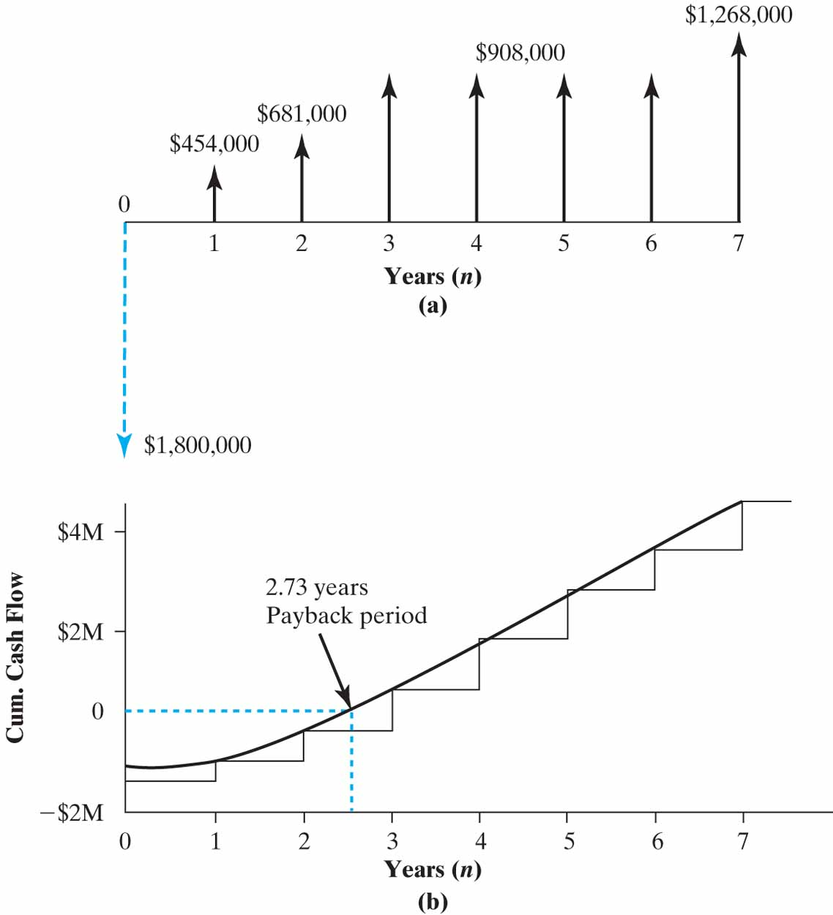
Cumulative Project Cash Flows over Time

Slide 7
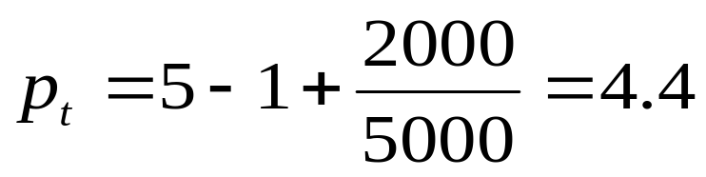
回收期=累计净现金流量开始出现正值的年份数-1+ [上年累计净现金流量的绝对值/当年净现金流量 ]
某项目的原始投资 元，以后各年净现金流量如下：
第1年 3000元
第2—10年 5000元
项目计算期l0年，求回收期。
解: 累计净现金流量开始出现正值的年份是第5年
-20000十3000十5000十5000十5000十5000＝ 3000＞0
回收期 (年)

Slide 8
5.1.2 Discounted Payback Period 动态回收期
Principle:
  How soon can I recover my initial investment plus interest?
Method:
  Based on cumulative discounted cash flows
Screening Guideline:
  If the discounted payback period (DPP) is less than or equal to some specified payback period, the project would be considered for further analysis.
Weakness:
  Cash flows occurring after DPP are ignored

Slide 9
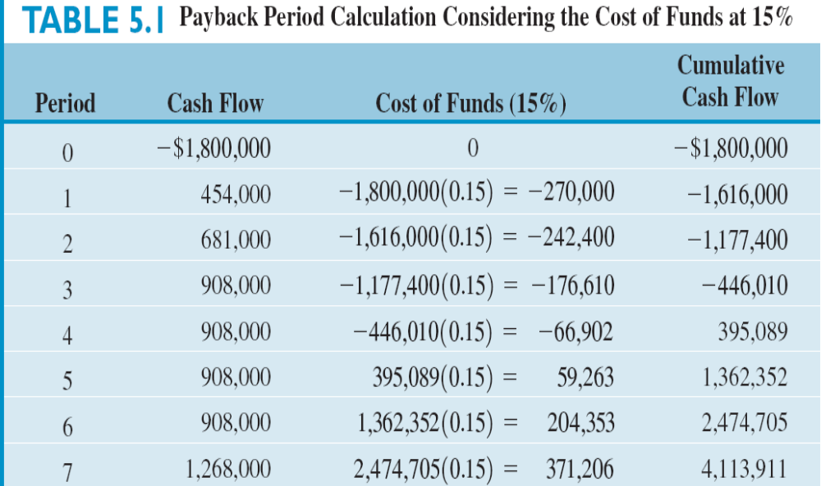
Discounted Payback Period
Example 5.2
* Cost of funds = (Unrecovered beginning balance) X (interest rate)

Slide 10
动态回收期=累计净现金流量折现值开始出现正值的年份数-1+[上年累计净现金流量折现值的绝对值/当年净现金流量折现值]:
  资料同前,求动态回收期.
  解:按现值计算的现金流量见下表
years | 0 | 1 | 2 | 3 | 4 | 5 | 6
Net cash flow | -20000 | 3000 | 5000 | 5000 | 5000 | 5000 | 5000
Discounted cash flow | -20000 | 2777.8 | 4286.7 | 3969.2 | 3675.1 | 3402.9 | 3150.8
Cumulative cash flow | -20000 | -17222.2 | -12935.5 | -8966.3 | -5291.2 | -1888.3 | 1262.5

Slide 11
Discounted payback period
=6-1+1888.3/3150.8=5.6 years

Slide 12
Practice 1
Calculate the conventional payback period and discounted payback period.
Period(n) | Cash flow($) | Cost of funds (15%) | Cash balance
0 | -85000 |  | -85000
1 | 15000 | -12750 | -82750
2 | 25000 | -12412 | -70162
3 | 35000 | -10524 | -45686
4 | 45000 | -6853 | -7539
5 | 45000 | -1130 | 36329
6 | 35000 | 5449 | 76778

Slide 13
Practice 2
Please use excel to calculate the conventional payback period and discounted payback period.
Period(n) | Cash flow($)
0 | -4500
1 | 2000
2 | 2000
3 | 2000
4 | 5000
5 | 5000
Assume i=10%

Slide 14
5.2 Net-present-worth criterion
Evaluation of a single project
Comparing more than one alternatives

Slide 15
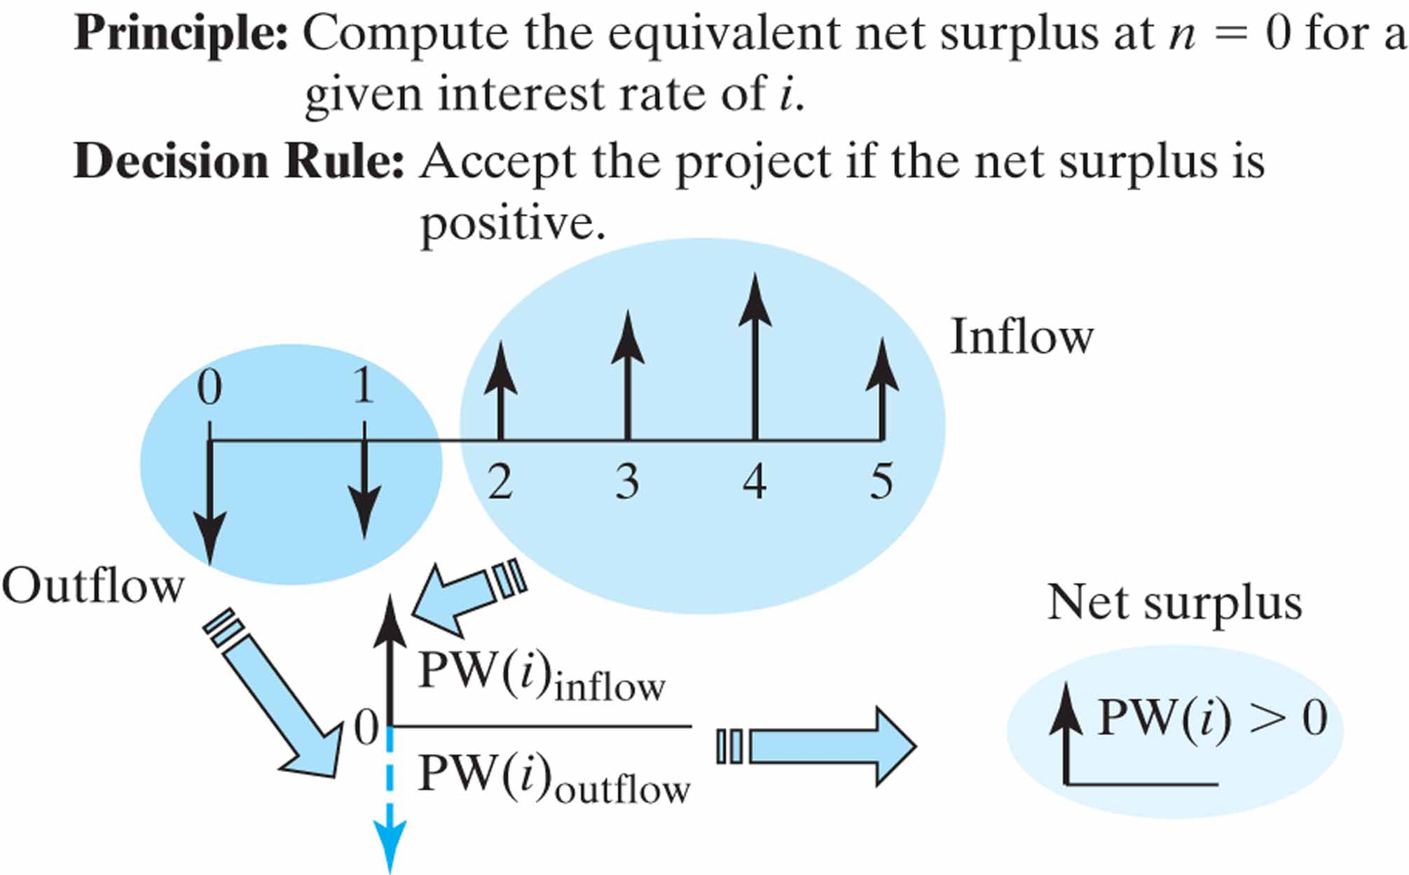
5.2.1 Evaluation of a single project

Slide 16
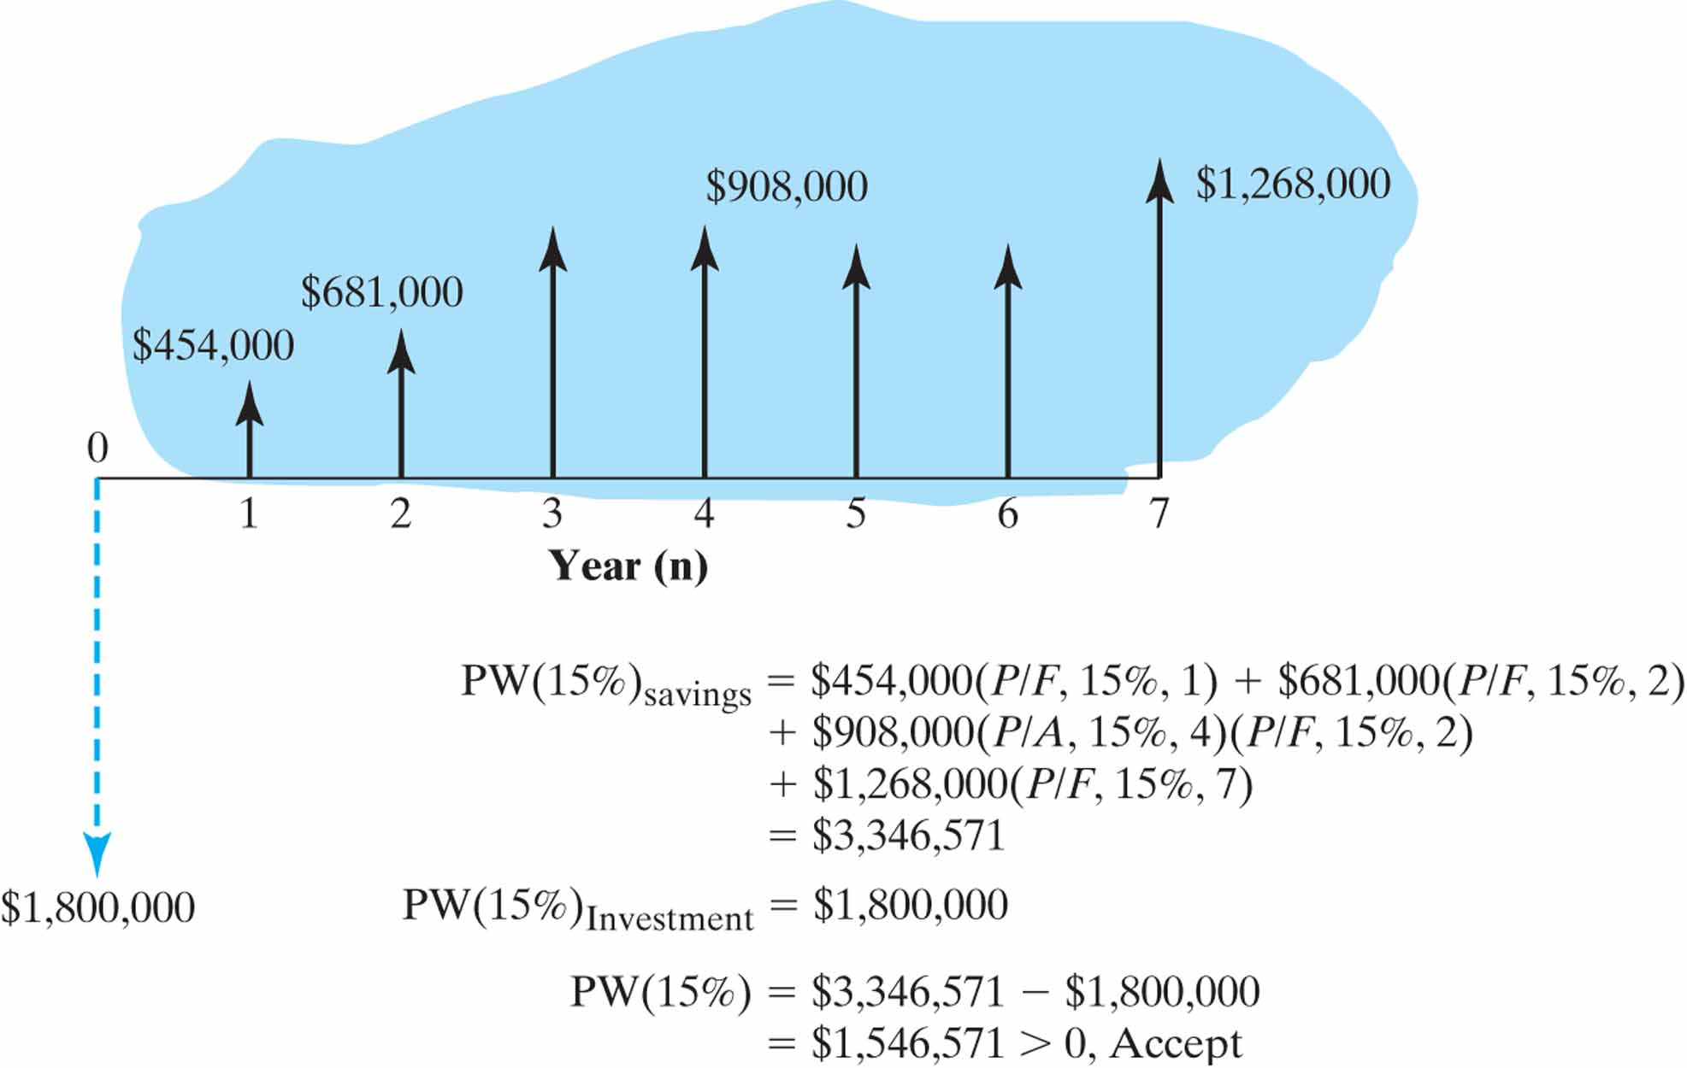
Example 5.3
i=15%

Slide 17


(1) Excel Solution :
 | A | B | C
1 | Period | Cash Flow
2 | 0 | ($1,800,000)
3 | 1 | $454,000
4 | 2 | $681,000
5 | 3 | $908,000
6 | 4 | $908,000
7 | 5 | $908,000
8 | 6 | $908,000
9 | 7 | $1,268,000
10 | PW(15%)= | $1,546,571
=NPV(15%,B3:B9)+B2

Slide 18
Practice 2:
 | A | B | C
1 | Period | Cash Flow
2 | 0 | ($1000)
3 | 1 | $600
4 | 2 | $800
5 | 3 | $1500
10 | PW(10%)= | ?
Please use excel to compute the net present worth
at i= 10%

Slide 19
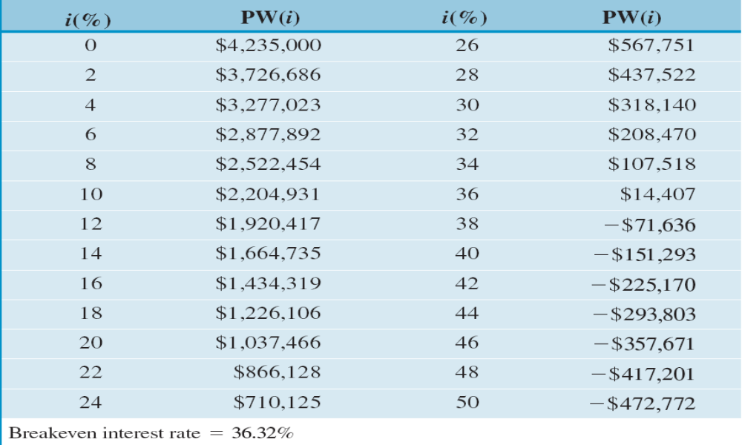
(2) Present Worth Amounts at Varying Interest Rates

Slide 20
Thinking about:
How to interpret PW(i)=0?
Or what does it mean to the business when Pw(i)=0?

Slide 21
5.2.2 break-even interest rate
There is an interest rate at which the NPV=0 (Pw=0)
Break-even interest rate (盈亏平衡分析）is also known as the internal rate of return (IRR)(内部收益率）。
Service lives 寿命期

Slide 22
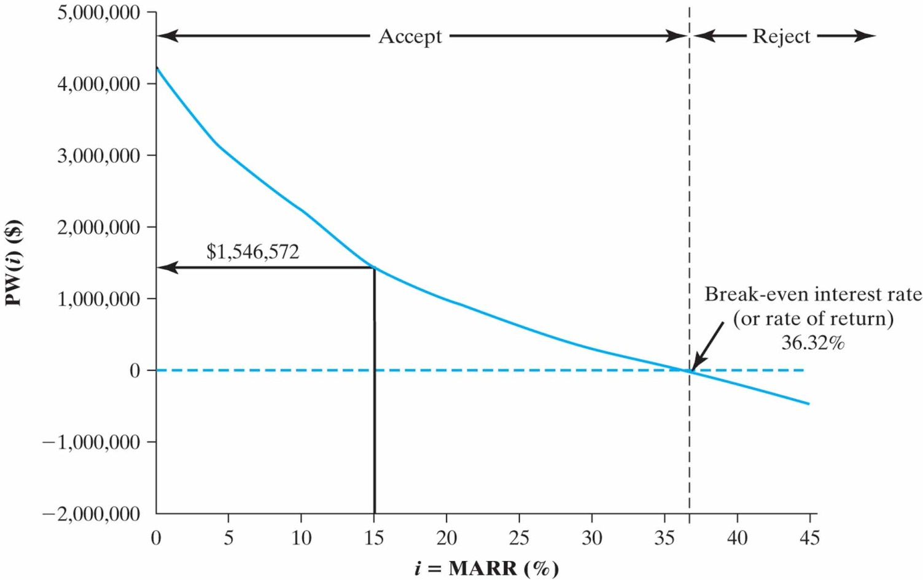
Net Present Worth Profile

Slide 23
5.2.3 Selecting a MARR
MARR (最低投资收益率） the interest rate is often referred to as either a required rate of return or a minimum attractive rate of return.
Return is what you get back in relation to the amount you invested.
The rate of return that we realistically expect to earn on any investment is a function of three components:
  Risk-free real return
  Inflation factor
  Risk premium(s)

Slide 24
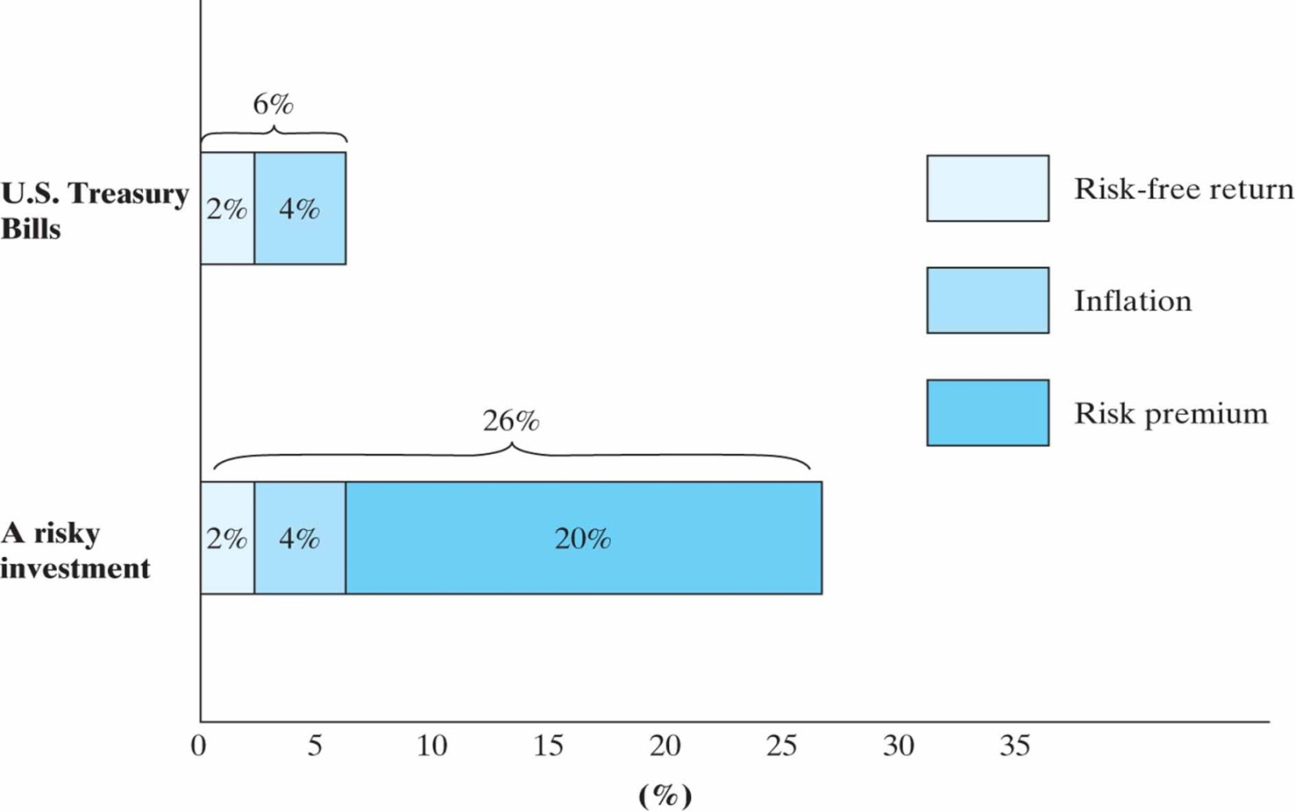
Elements of Required Return (MARR)

Slide 25
Thinking about:
What is the connection between IRR & MARR ?

Slide 26
Net Present Worth Profile

Slide 27
Can you explain what a typical NPV really means?
Suppose the company has $1,800,000. It has two options.
Option 1:Take the money out and invest it in the project or
Option 2: Leave the money in the firm’s treasury that can be placed in investments that yield a return equal to the MARR. These funds may be viewed as an investment pool.
Let’s see what the consequences are for each option.

Slide 28
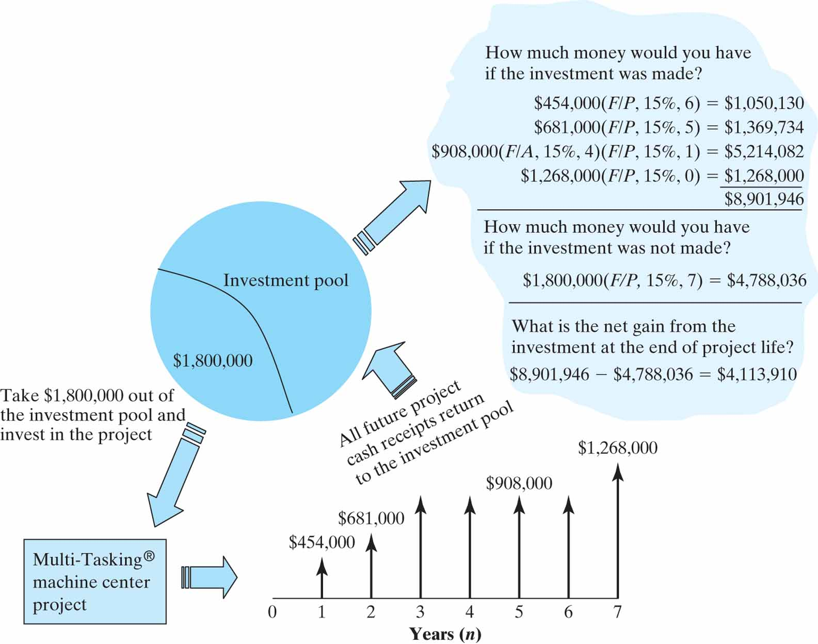
The Concept of Investment Pool

Slide 29
5.2.4 Capitalized Equivalent Worth等值资本化
A special case of the PW criterion is useful when the life of a proposed project is perpetual or the service life is extremely long.
The capitalized cost represents the amount of money that must be invested today in order to yield a certain return A at the end of each and every period forever.

Slide 30
When n approaches infinity:
because:
lim(p/A,i,N)=lim [[(1+i)^{N}-1]/i(1+i)^{N}]=1/i
So :
PW(i)=A(P/A,i,N)=A/i

Slide 31
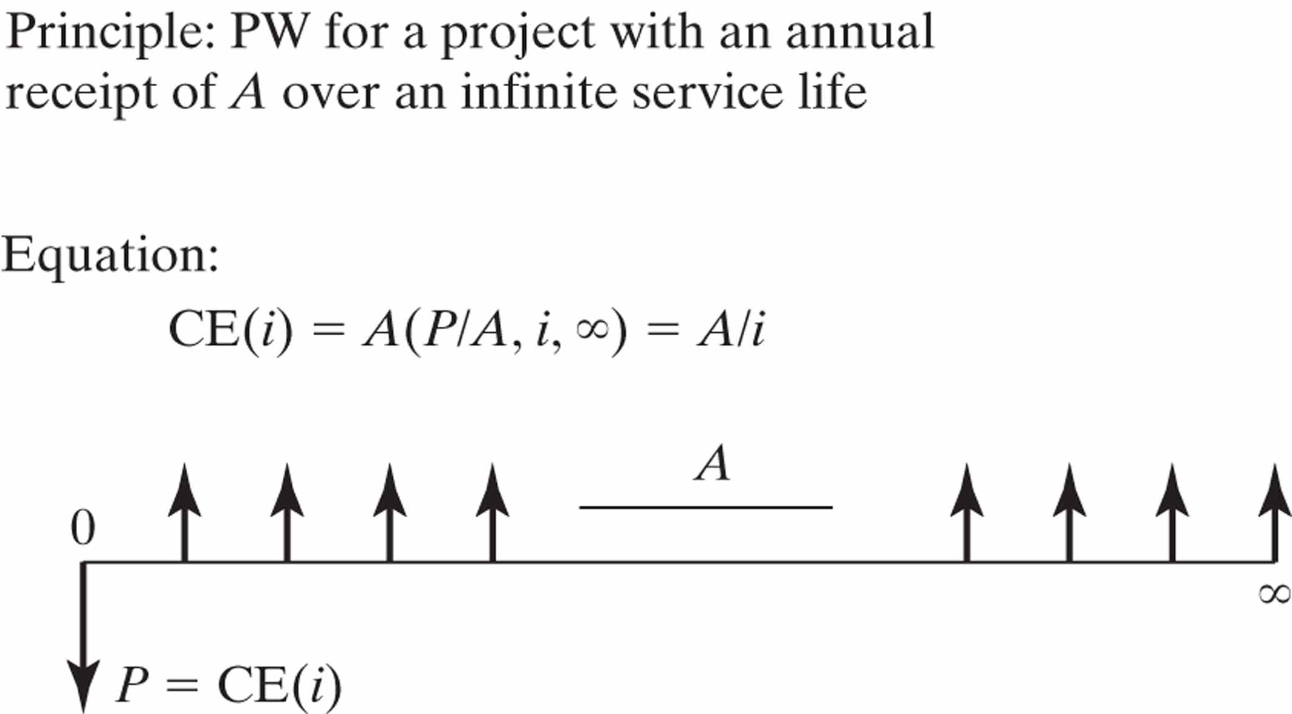

Slide 32
Example 5.4
An engineering school conducted a campaign targeting alumni to raise funds for future maintenance costs, which are estimated at $2million per year. Assuming that the school can create a trust fund that earn 8% interest annually, how much has to be raised now to cover the perpetual string of $2 million annual costs?

Slide 33
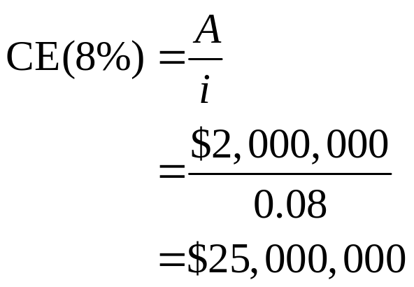
Given: A = $2M, i = 8%, and N = ∞
Find: CE(8%)
Solution:
A = $2,000,000
0
1 2 3
∞
CE(8%) = $25,000,000

Slide 34
3. Comparing Mutually Exclusive Alternatives
Mutually Exclusive Projects 两个互斥方案
Alternative vs. Project
Do-Nothing Alternative

Slide 35
5.3.1 Two pairs of terms
The first pair:
Analysis Period
    The time span over which the economic effects of an investment will be evaluated (study period or planning horizon).
Required Service Period
    The time span over which the service of an equipment (or investment) will be needed.
(analysis period = required service period)
Project life

Slide 36
The second pair:
Revenue Projects
    Projects whose revenues depend on the choice of alternatives---largest net gains
Service Projects
    Projects whose revenues do not depend on the choice of alternative but must product the same amount of output (revenue)—lower production cost

Slide 37
5.3.2 Fundamental Principle in Comparing Mutually Exclusive Alternatives
Principle: Projects must be compared over an equal time span (or analysis period).
Rule of Thumb: If the required service period is given, the analysis period should be the same as the required service period.

Slide 38
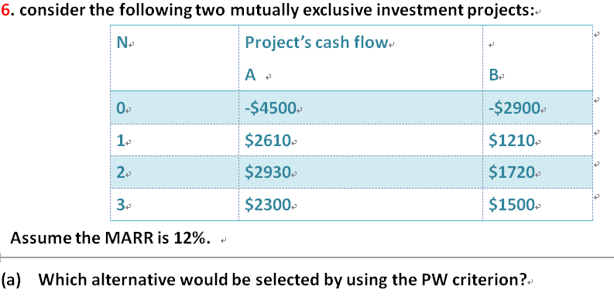
Case 1: Analysis Periods equal Project lives

Slide 39
Case 2: Analysis Periods are Shorter than Project Lives
Estimate the salvage value 残值 at the end of the analysis period.
Compute the PW for each project over the analysis period.
Select the least cost alternative.

Slide 40
Salvage value 残值 is the amount of money for which the equipment could be sold after its service to the project has been rendered.

Slide 41
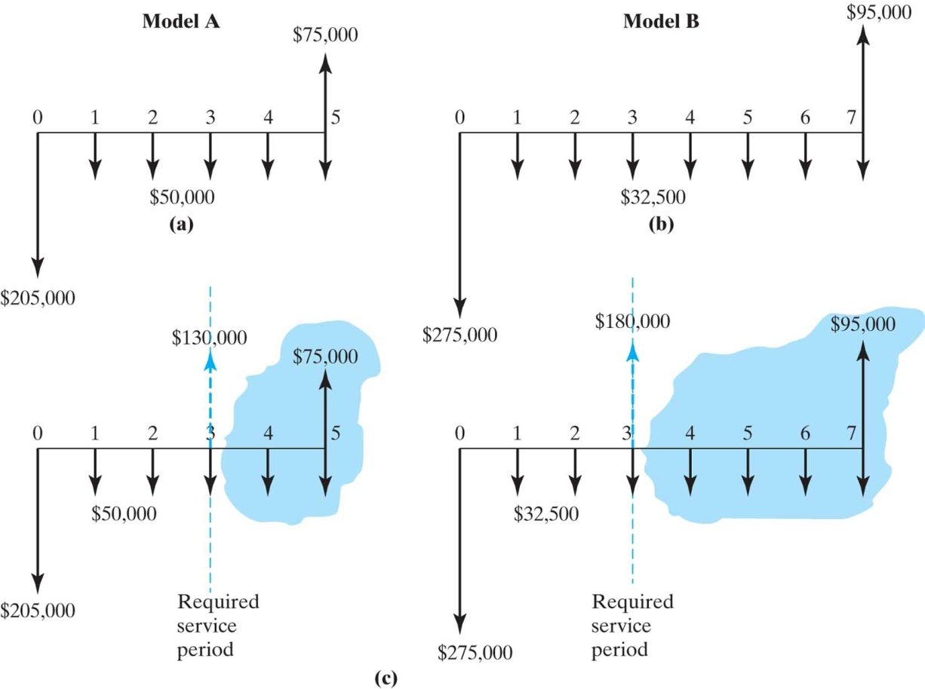
Project’s Life is Longer than Analysis Period
Example 5.7
PW(15%) = -$230,852
PW(15%) = -$233,684

Slide 42
Case 3: Analysis Period is Longer than Project Lives
lowest common multiple of projects’ lives （最小公倍数法）
Choose the lowest multiple of project lives as our analysis period. The same cash flow pattern repeats within these years.

Slide 43
Example 5.8
The cash flows of A and B projects are shown in the table. The interest rate is 15%, which one is better?
A | -2300 | -250 | -250 | -250
B | -3200 |  |  |  | 400
Method 1. NPV as a criterion.
NPV_{A}=-2300-2300(P/F 15,3)-2300(P/F 15,6)-2300(P/F 15,9)-250(P/A15,12)= -6819
NPV_{B}=-3200-2800(P/F15,4)-800(P/F15,8)+400(P/F15,12)= -5612

Slide 44
Practice 3
Which is the most economical bid if the interest rate is considered to be 11%? Either tower will have no salvage value after 20 years of use.
 | Bid A ($) | Bid B ($)
Equipment cost | 112000 | 98000
Installation cost | 25000 | 30000
Annual maintenance | 2000 | 2500
Annual extra taxes | ---- | 800
Life | 40 years | 35 years
Salvage value | 0 | 0

Slide 45
Summary
We presented the concept of present-worth analysis based on cash flow equivalence along with the payback period.
Payback period
The MARR， is the interest rate at which a firm can always earn or borrow money, and is the rate at which PW analysis should be conducted.

Slide 46
Using PW to make decisions:
A single project: PW(i)>0
Mutually exclusive projects:
  Revenue projects and service projects
  （larger net gain lower cost）
  Analysis period & project period(service period) are different:
  choose an analysis period
  (2) the least common multiply of project lives

Slide 47

Question: this chapter is about PW analysis, then how about annual equivalence analysis?

